Slide 1


Slide 2

Neuroimaging (pictures INSIDE your head)

Slide 3


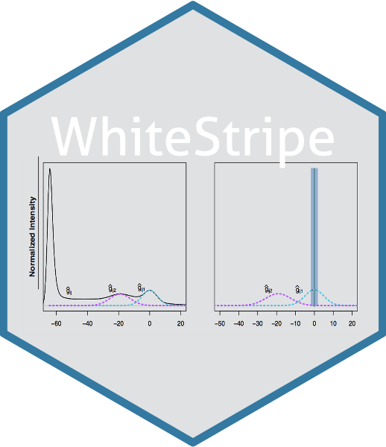



R Packages

Slide 4
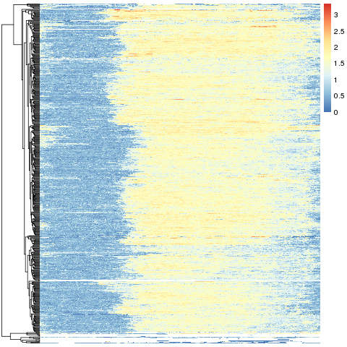
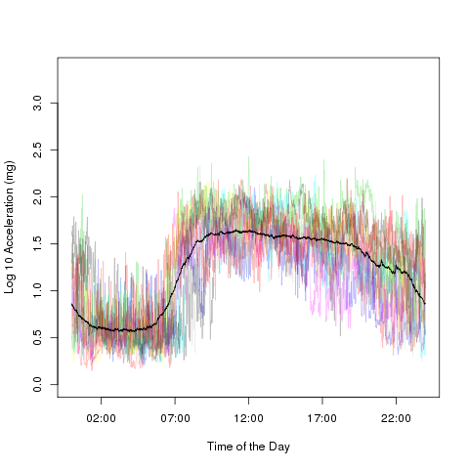
UK Biobank data – over 100,000 people!

Slide 5
Things currently bothering me
With a binary predictor
- what should the ROC curve look like?
- how should the AUC be calculated?

Slide 6
Data Science!?

